Slide 1
Monday, 4/25/22
Any Questions?
Project 6
Course Evaluation
Networking (Module 22)
End of Semester is Here
Other Data Structures
Final Exam

Slide 2
Topics
Client / Server Communications
Internet Protocol
Sockets
Application Protocols
Internet Application Protocols
HTTPS

Slide 3
Additional Resources
Java Socket Programming Part 1
https://www.youtube.com/watch?v=BWjGQlIkgT4
Internet Protocol

Slide 4
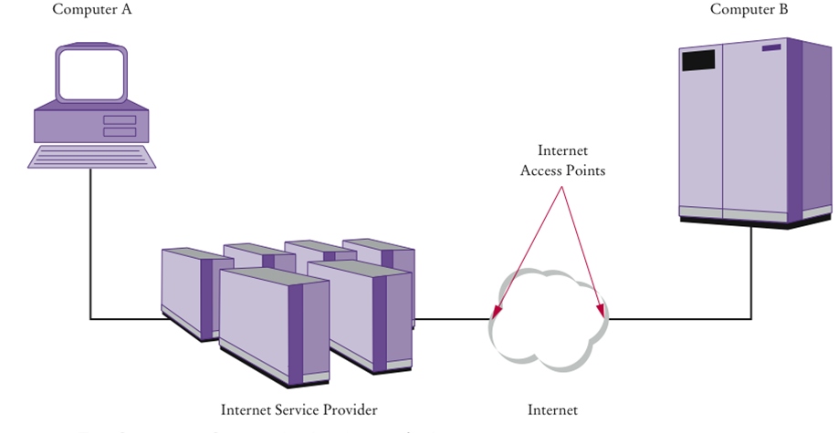
Internet | Networking
This is a complex topic

Slide 5
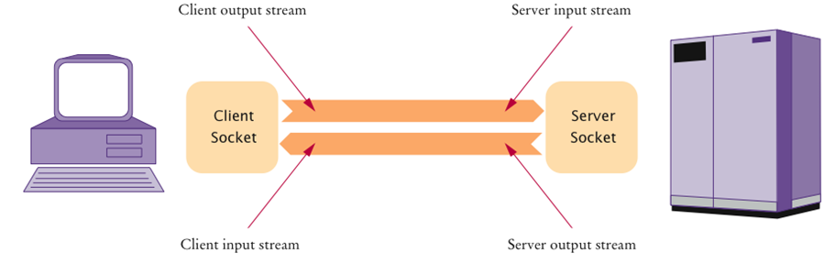
Client and Server Sockets
Visiting montgomerycollege.edu
Notes:
Visiting cnn.com

Slide 6
Sending Data From A to B
A is your home computer
It is connected to an Internet Service Provider (ISP)
ISP is connected to an Internet Access Point
B is on a local area network at XYZ Company
XYZ has its own Internet Access Point
Internet Access Points are connected by a complex collection of pathways (the Internet)
Over these pathways a message sent from one access point can eventually reach any access point

Slide 7
The Internet
Internet
Uses a common set of protocols to define how the parties will interact with each other
Internet Protocol (IP)
Developed to enable different local area networks to communicate with each other
Has become the basis for connecting computers around the world together over the Internet
Transmission Control Protocol (TCP)
Most commonly used Internet services use TCP with IP (TCP/IP)
USPS vs. Internet
Protocols

Slide 8
Transmission Control Protocol
Internet Protocol (IP) does not notify the sender if data is lost or garbled
This is the job of a higher level protocol Transmission Control Protocol (TCP)
Attempt to deliver the data
Try again if there are failures
Notify the sender whether or not the attempt was successful
It’s fairly reliable

Slide 9
Destination Address
Data must be marked with a destination address
In IP, addresses are denoted by a sequence of four numbers
For example 130.65.86.66
Each is one byte (a number between 0 and 255)
To be able to accommodate more devices, IP addresses has been extended to sixteen bytes (IPv4 vs. IPv6)
https://www.avast.com/c-ipv4-vs-ipv6-addresses
To send data to B, A needs to know B’s IP (address)
A includes that address in the protocol portion when sending the data

Slide 10
Domain Naming Service
In addition to an IP address, computers can have an easy-to-remember domain name
For example, montgomerycollege.edu
Domain Naming Service (DNS): translates from domain name to IP address
When A wants to request data from a domain name:
It asks the DNS for the numeric Internet Address
It includes the numeric address with the request for data
The ping command

Slide 11
Client | Server Communications
The server must be running when a client starts. The server waits for a connection request from a client. To establish a server, you need to create a server socket and attach it to a port, which is where the server listens for connections.
After the server accepts the connection, communication between server and client is conducted the same as for I/O streams.
After a server socket is created, the server can use this statement to listen for connections.
The client issues this statement to request a connection to a server.

Slide 12
Serving Multiple Clients
Multiple clients are quite often connected to a single server at the same time. Typically, a server runs constantly on a server computer, and clients from all over the Internet may want to connect to it. You can use threads to handle the server's multiple clients simultaneously. Simply create a thread for each connection. Here is how the server handles the establishment of a connection:
while (true) {
Socket socket = serverSocket.accept();
Thread thread = new ThreadClass(socket);
thread.start();
}
The server socket can have many connections. Each iteration of the while loop creates a new connection. Whenever a connection is established, a new thread is created to handle communication between the server and the new client; and this allows multiple connections to run at the same time.
Notes:
Servicing multiple clients (threads)

Slide 13
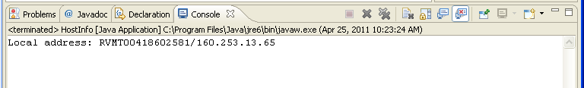
Activity | Your Local IP Address
Run IP_Address.java
https://whatismyipaddress.com/
Notes:
Local IP Address

Slide 14
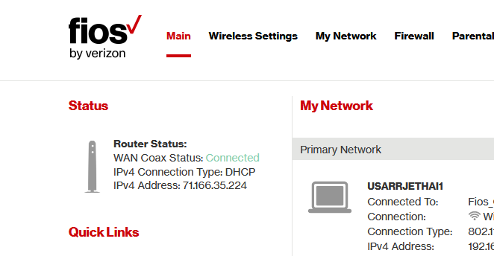
Public vs. Private IP Address
https://digitalmediaglobe.com/public-vs-private-ip-address-differences-and-ranges/
Ipconfig
Verizon Router: 192.168.1.1
Notes:
Local IP Address

Slide 15
Port Numbers
Multiple services can be offered on a server
Both a web server program and an email server program
When data are sent to that computer, they need to indicate which program is to receive the data
IP uses port numbers for this
A port number is an integer between 0 and 65,535
Sending program must know the port number of receiving program
Port number is included in the transmitted data
Web servers usually use ports 80, 443
POP mail servers usually use port 110
Well known ports
https://en.wikipedia.org/wiki/List_of_TCP_and_UDP_port_numbers

Slide 16
Data Transmission
Consists of sending/receiving streams of zeros and ones along the network connection
Two types of information:
Application data
The information one computer wants to send to another
Network protocol data
Describes how to reach the intended computer
Describes how to check for errors in the transmission

Slide 17
Packets
IP breaks large chunks of data up into more manageable packets
Each packet is delivered separately
Each packet in a larger transmission may be sent by a different route
Packets are numbered
The recipient reassembles the data
How large is a IP data package?
Minimum size of an IP packet is 21 bytes (20 bytes for the header, and 1 byte of data). The maximum size is 65,535 bytes
https://www.oreilly.com/library/view/internet-core-protocols/1565925726/re04.html

Slide 18
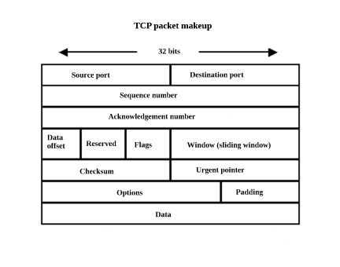
TCP Packet | Contents
Internet address of the recipient
Port number of the recipient
Internet address of the sender
Port number of the sender

Slide 19
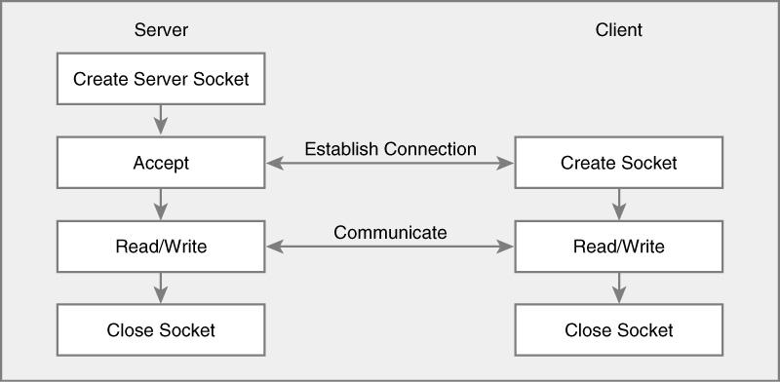
Socket and Server Sockets
When establishing a connection, one machine actively establishes the connection (client), whereas the other machine takes a passive role & waits for a connection request (server)
Socket & ServerSocket classes provide reliable stream-oriented delivery using TCP

Slide 20
Sockets
Socket is an object that encapsulates a TCP/IP connection
There is a socket on both ends of a connection
Create a socket in a Java program
Socket s = new Socket(hostname, portnumber);
If it can’t find the host, the Socket constructor throws an UnknownHostException

Slide 21
Sockets – Input / Output Streams
Use the input and output streams attached to the socket to communicate with the other endpoint
Obtain the input and output streams:
InputStream instream = s.getInputStream(); OutputStream outstream = s.getOutputStream();
When you send data to outstream, the socket forwards them to the server
The socket catches the server’s response and you can read it through instream
When you are done communicating with the server, close the socket:
s.close();

Slide 22
Scanners and Writers
InputStream and OutputStream send and receive bytes
To send and receive text, use a scanner and a writer:
Scanner in = new Scanner(instream); PrintWriter out = new PrintWriter(outstream);
A PrintWriter buffers the characters and only sends when the buffer is full
Buffering increases performance
When sending a command, if you want the whole command to be sent now
Flush the buffer manually:
out.print(command); out.flush();

Slide 23
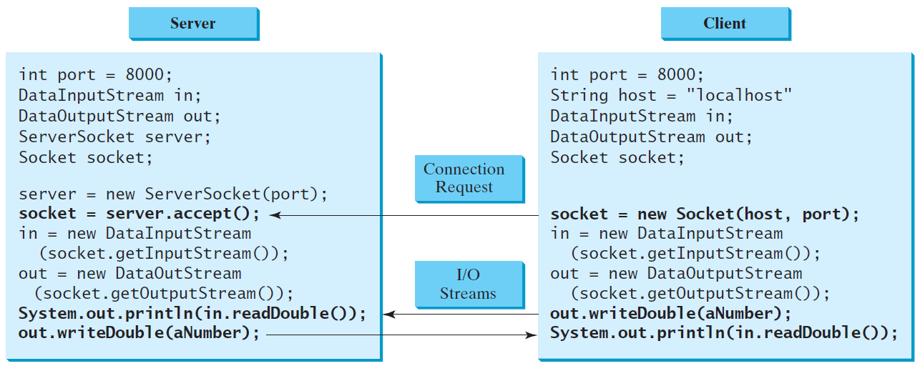
Data Transmission through Sockets
InputStream input = socket.getInputStream();
OutputStream output = socket.getOutputStream();
Notes:
Why port – 8000?

Slide 24
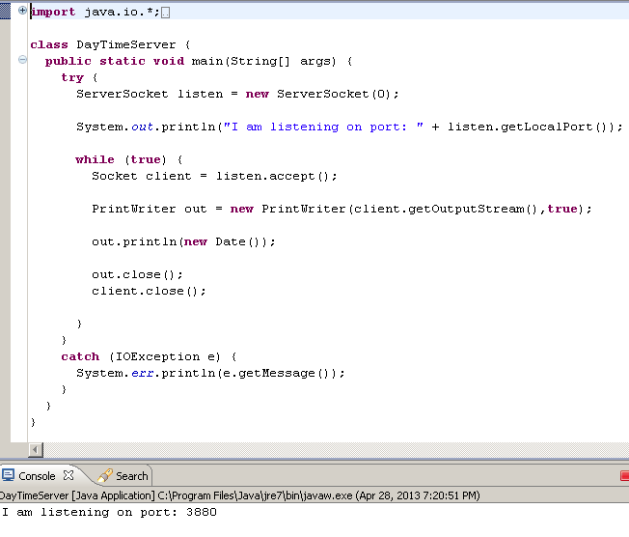
Activity | Client / Server Example

Slide 25
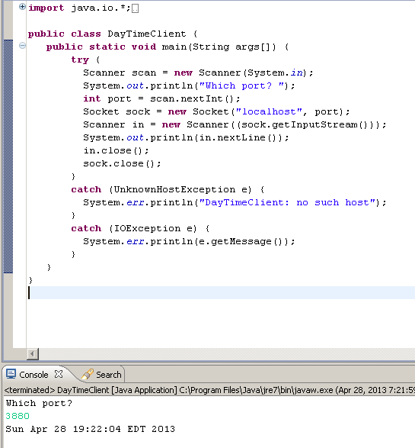
Client / Server Example
(Then start the Client program)

Slide 26
Internet Protocols
Internet Protocols: HTTP, HTTPS, FTP
HTTPS is one of many application protocols in use on the Internet
Another commonly used protocol is the Post Office Protocol (POP)
POP is used to download received messages from e-mail servers
To send messages, you use another protocol: Simple Mail Transfer Protocol (SMTP)

Slide 27
HTTPS
HTTPS is a protocol that describes the command set for web server requests
Web browsers
Know how to display HTML documents
And how to issue HTTPS commands
Web servers
Know nothing about HTML
Merely understand HTTPS and know how to fetch the requested items

Slide 28
HTTPS Commands
Command | Meaning
GET | Return the requested item
HEAD | Request only the header information of an item
OPTIONS | Request communications options of an item
POST | Supply input to a server-side command and return the result
PUT | Store an Item on the server
DELETE | Delete an item on the server
TRACE | Trace server communication

Slide 29
Application Level Protocols
TCP/IP mechanism establishes an Internet connection between two ports on two computers
Each Internet application has its own application protocol
Protocol describes how data for that application are transmitted
Online Banking Example
Client Request | Server Response | Description
BALANCE n | n and the balance | Get the balance of account n
DEPOSIT n a | n and the new balance | Deposit amount a into account n
WITHDRAW n a | n and the new balance | Withdraw amount a from account n
QUIT | None | Quit the connection

Slide 30
Application Level Protocol
When you develop a client / server application, you need some application-level protocol
Clients use protocol to interact with server
Example – enables clients to manage bank accounts in a bank

Slide 31
Online Banking
BankServer
Bank
creates
accept
creates Thread
reference to socket
reference to Bank
BankClient
1
print
balance(acct, amt)
deposit(acct, amt)
withdraw(acct,amt)
read
BankService1
read
print
Notes:
Bank (BankAccount)

Slide 32
Bank Example | The Server
The server waits for clients to connect on a certain port
We choose 8888
To listen for incoming connections, use a server socket
To construct a server socket, provide the port number:
ServerSocket server = new ServerSocket(8888);
Use the accept method to wait for client connection and obtain a socket:
Socket s = server.accept(); BankService service = new BankService(s, bank);

Slide 33
BankService (Server)
BankService carries out the service
Implements the Runnable interface
Its run method will be executed in each thread that serves a client connection
run gets a scanner and writer from the socket, then executes:
public void run() {
. . . while (true) { if (!in.hasNext()) return; String command = in.next(); if (command.equals("QUIT")) return; executeCommand(command); } }

Slide 34
ExecuteCommand (Server)
Processes a single command
If the command is DEPOSIT, it carries out the deposit
int account = in.nextInt(); double amount = in.nextDouble(); bank.deposit(account, amount);
WITHDRAW is handled in the same way
After each command, the account number and new balance are sent to the client:
out.println(account + " " + bank.getBalance(account));

Slide 35
The Server
Then returns to the run method if the client closed the connection or the command equals QUIT
Then run closes the socket and exits
How can we support multiple simultaneous clients?
Spawn a new thread whenever a client connects
Each thread is responsible for serving one client

Slide 36
The Server – Threads
BankService implements Runnable; so, it can start a thread using start() (of class Thread)
The thread terminates when the client quits or disconnects and the run method exits
In the meantime, BankServer loops back to accept the next connection
while (true) { Socket s = server.accept(); BankService service = new BankService(s, bank); Thread t = new Thread(service); t.start(); }
The server program never stops
When you are done running the server, you need to kill it

Slide 37
BankAccount
BankService
2
print
read
read
BankClient
2
balance(acct, amt)
deposit(acct, amt)
withdraw(acct, amt)
print
deposit(amt)
withdraw(amt)
getBalance(amt)
creates Thread
reference to socket
reference to Bank
BankServer
accept
Bank
creates
accept
creates Thread
reference to socket
reference to Bank
BankClient
1
print
balance(acct, amt)
deposit(acct, amt)
withdraw(acct,amt)
read
BankService1
read
print

Slide 38
Activity | Messages
Example

Slide 39
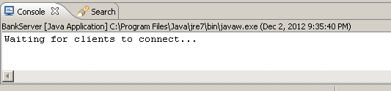
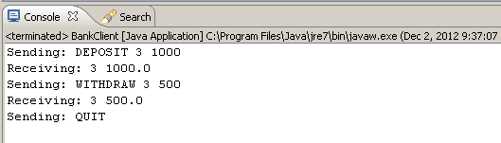
Activity | Online Banking
Start the BankServer
Start the BankClient

Slide 40
Activity
Modify Online Banking Example

